Slide 1

REVIEW Deep learning
Paper authored by
Yann LeCun, Yoshua Bengio, & Geoffrey Hinton
Summarized and presented by
Thomas Scott, Drew Burritt, Jose Carlos Cazarin Filho, Bhavyai Gupta, and Michael Man Yin Lee
23-FEB-2022

Slide 2
Deep Learning: ML in Style
Machine learning is a powerful yet conventionally limited technology
Need strong domain expertise, engineering effort
Difficult to process raw data
Deep learning corrects for these issues
Can process raw data
Minimal human engineering required
Can identify intricate structures in high dimensional data

Slide 3
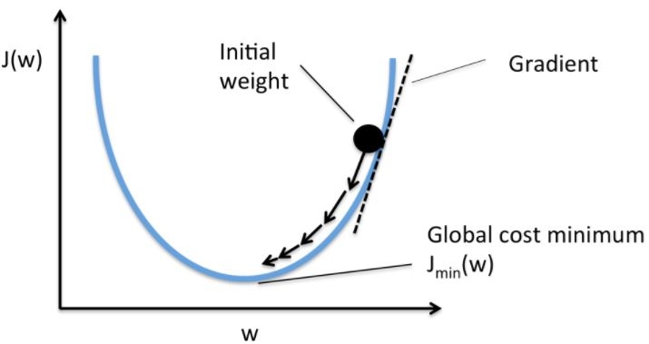
Supervised Learning
The most common form of deep learning
Take labelled set of data and train model on it
Adjust model accuracy using parameters (weights)
Weights adjusted through a gradient vector
Change weights according to computed error
Weight adjusted opposite to its gradient (minimize error)
Image reference:
https://www.oreilly.com/library/view/neural-networks-with/9781788397872/1fd85f1c-a528-4acd-b3e2-f45cd0d1cf12.xhtml

Slide 4
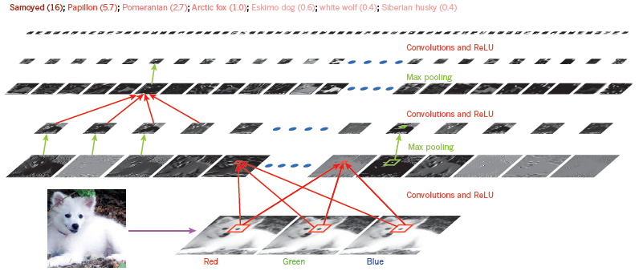
Supervised Learning
Deep learning models comprised of multiple layers
Each layer subject to supervised learning
Each layer trains on previous layer
Each layer more abstract (higher dimension) than the last
Can distinguish between dog and wolf!

Slide 5
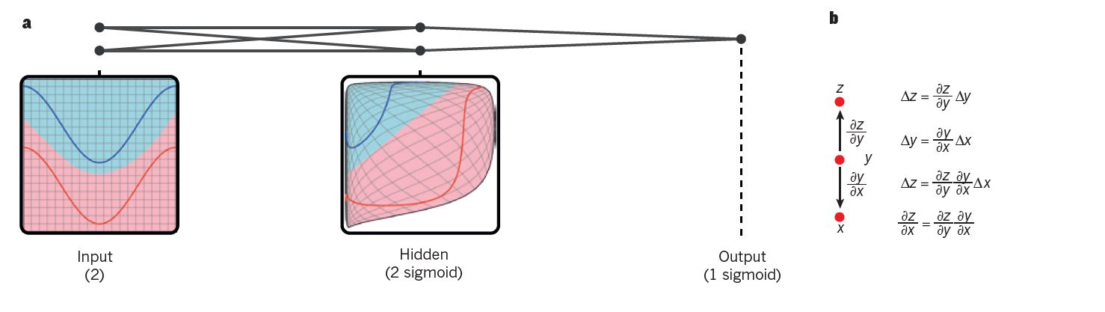

Backpropagation
Y. LeCun, Y. Bengio, and G. Hinton, “Deep learning,” Nature, vol. 521, no. 7553, pp. 436–444, 2015. ​
Presenter: Drew Burritt
Notes:
Backpropagation is an algorithm used in the training of feedforward neural networks. Backpropagation is used to compute the gradient of an objective function, with respect to the weights of the network. The backpropagation algorithm works by starting with the error at the output and working backwards, propagating the gradient through each layer to the input.
This image on the left shows how a network uses backpropagation to distort the input space in order to make classes linear separable. In the 90s it was first thought that neural networks and backpropagation using this gradient descent would have poor performance as the model would get stuck in local minima, where small changes would not reduce the error. However in practice this is rarely the case as the majority of these points result in solutions of similar quality.
Backpropagation is practical application of the chain rule for derivatives. The equations on the right show how the chain rule can be used to relate two small changes, the change of x on y and of y on z. A small change in x, delta x is transformed into a change in y, delta y by multiplying by the partial derivate dy/dx.
Similarly Delta Y is then related to the change in Z, delta z. This shows us how the change in x, delta x is related to delta z, through the multiplication of dy/dx and dz/dy. This also works when x,y and z are vectors and the derivatives are jacobian matricies.

Slide 6
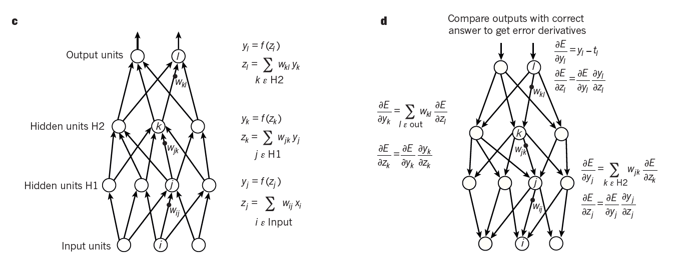
Backpropagation
Y. LeCun, Y. Bengio, and G. Hinton, “Deep learning,” Nature, vol. 521, no. 7553, pp. 436–444, 2015. ​
Presenter: Drew Burritt
Notes:
The first step in the backpropagation algorithm is forward propagation, this is where the total input to each layer is calculated, this is a weighed sum of the previous outputs. Then a non linear function, typically RELU or sigmoid, is applied to get the final output for the node. Once the final output is achieved the error between the output and the target is calculated. This is then used to compute the error derivative with the respect to the output of each node. The error derivative with respect to the output is then converted into the error derivative with respect to the input by multiplying it by the gradient. These values are then used to update the weights in order to minimize the error. This is propagated backwards through the network, repeating these steps at each layer until the input layer is reached.

Slide 7
Convolutional Neural Networks (CNN)
4 key ideas:
Local connections
Shared Weights
Pooling
Many layers
Notes:
Paper presents us with 4 key ideas behind convolutional neural networks: say the ideas
We explored those ideas briefly in our classes…
12 seconds

Slide 8

Convolutional Neural Networks (CNN)
Local connections and shared weights
Correlation of local groups of values
Motifs (features) can appear anywhere
Same weights detect the same pattern
Image Reference: https://petewarden.com/2017/10/29/how-do-cnns-deal-with-position-differences/
Notes:
The concept behind local connections is that local groups of values are highly correlated, and they form distinctive local features that can be easily detected
CNNs are invariant to translation, which means that they can detect features regardless of positional shifts or translations of such features
For example, in those two figures here, us humans can easily identify the Sun regardless of its position.
CNNs can do that as well, by using filters that learn to identify such objects, and those filters are composed by a set of weights that doesn’t rely on the location of the object within the image
38 secs
Petal sun
Petal facing up
Petal facing left
Yellow circles surrounded by petals

Slide 9

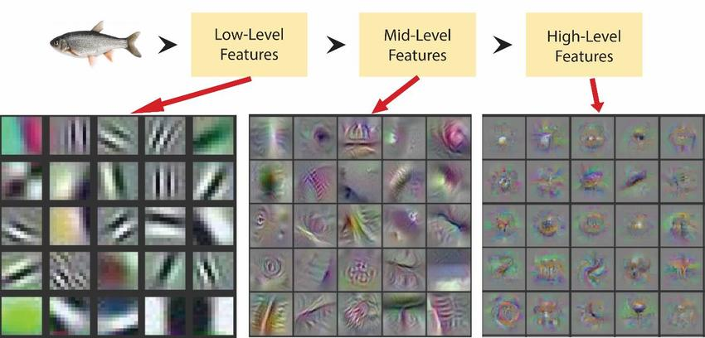
Convolutional Neural Networks (CNN)
Pooling and many layers
Merge semantically features into one
Reduces the dimension of the representation
Low level feature to high level feature
INPUT
OUTPUT
Pooling
Notes:
CNNS explore the properties that natural signals are compositional hierarchies, which means that higher-level features are obtained from composing lower-level features
Each layer in a CNN acts on the output of the previous layer. The closer to the input a layer is, the data it is acting upon gets rawer, in another words, it is less organized
So, the first layers learn to detect lower-level features, and in the case of images, it can be simple straight edges
As we get deeper into the network, layers learn how to detect more complex features like curved edges, and then shapes, and then textures, and so on so forth
Another operation that’s happening in between layers is the pooling: pooling means picking the maximum value of a local group of features and discarding the rest, this reduces the
dimension of the representation, the effect is creating an invariance to small shifts and distortions in the output of each layer
Going back to the Sun example of the previous slide, you can think that after a pooling layer, the number of possible places in the image where the Sun can be is reduced
Invariance to small shifts and distortions
Image: edges to features, features to parts, parts to objects
Sound: sounds to phones, phones to phonemes, to syllables, to words and to sentences

Slide 10
Convolutional Neural Networks (CNN)
Reason for success:
GPUs
Augmentation
Faster training
Notes:
The paper cites some reasons for the success of CNNs:
Efficient use of GPU’s
More training examples due to data augmentation
And faster training due to progress in hardware, software and algorithm parallelization.

Slide 11
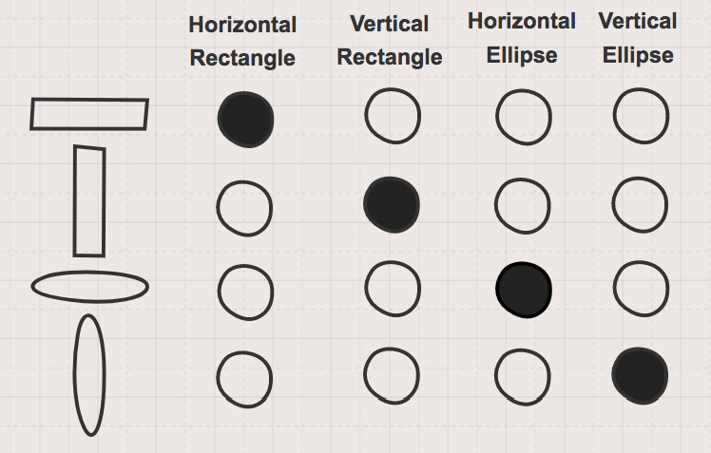
Localist/non-distributed representations
Localist/non-distributed (like one-hot encoder) representation of input is inefficient whenever the data has componential structure
Dimensionality of representation grows as input grows
Doesn’t provide information how input relate to each other
Features are not mutually exclusive
Figure: Sparse or local, non-distributed representation of shapes. Image by Garrett Hoffman
Content reference: https://www.oreilly.com/content/how-neural-networks-learn-distributed-representations/
http://www.cs.toronto.edu/~bonner/courses/2014s/csc321/lectures/lec5.pdf
Notes:
To understand distributed representation, first let us talk about non-distributed representation, sometimes also called as localist representation. Localist representation is like what we get from a one-hot encoder. It is easy to understand and code by hand, but it is very inefficient whenever the data has componential structure. Take an example given in the figure on the right hand side. Here we are using local representation to represent given input shapes. There are three problems with this approach. First, whenever there is an additional input, we need to increase our dimensionality. Second, it doesn’t tell how shapes like “Horizontal Rectangle” and “Vertical Rectangle” are related to one another. Lastly, if a feature is common between multiple inputs, there’s no way to differentiate.

Slide 12
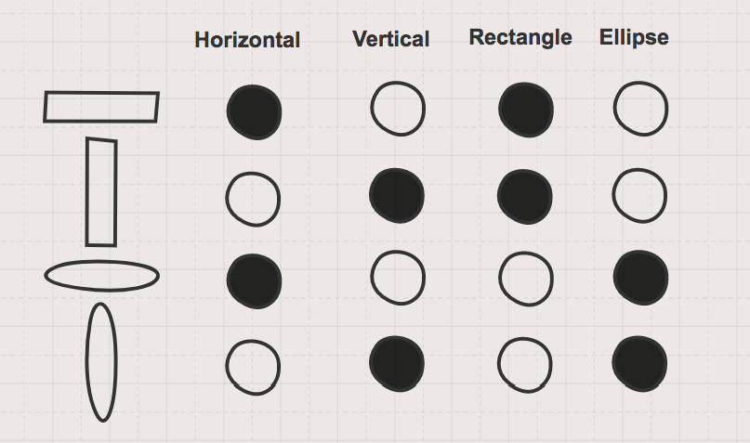
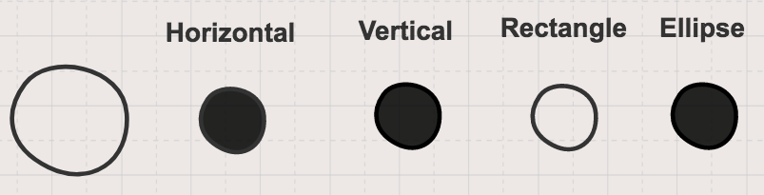
Distributed representations
“Distributed representation” means a many-to-many relationship between two types of representation (such as concepts and neurons).
Each concept is represented by many neurons
Each neuron participates in the representation of many concepts
E.g., use n features with k values each to describe k^{n} different combinations
Figure: Distributed representation of shapes. Image by Garrett Hoffman
Figure: Distributed representation of a circle; This representation is more useful as it provides us with information about how this new shape is related to our other shapes. Image by Garrett Hoffman
Content reference: http://www.cs.toronto.edu/~bonner/courses/2014s/csc321/lectures/lec5.pdf https://cedar.buffalo.edu/~srihari/CSE676/15.4%20DistributedRepresentation.pdf
Notes:
These inefficiencies in the local representation are addressed by distributed representations, where there is a many-to-many relationship between two types of representations such as concepts and neurons. So, each concept is represented by many neurons and each neuron participates in the representation of many concepts. Again taking the similar example, with distributed representation we can tell how a particular shape is related to any other shape, like “Horizontal Rectangle” and “Vertical Rectangle”. Also, an additional input like “Circle” can be accommodated by a yet another combination of the neurons. An added benefit of distributed representation is its compactness, as for n binary features we can describe 2 raise to the power n different combinations.

Slide 13
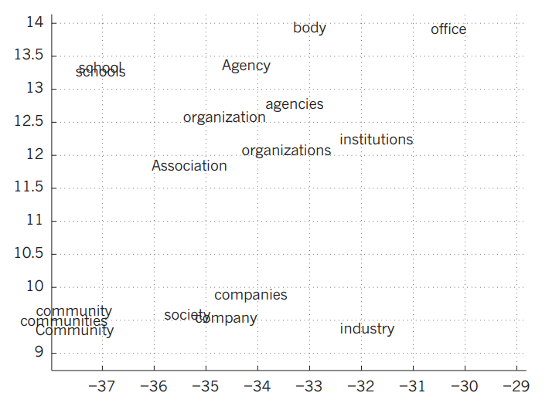
Neural language processing model
Earlier the approach was based on counting frequencies of occurrences of short symbol sequences of length up to N (called N-grams)
N-grams treat each word as an atomic unit, so they cannot generalize across semantically related sequences of words
Neural language models exploit distributed representations
Associate each word with a vector of real valued features, and semantically related words end up close to each other in that vector space
Figure: An illustration of word representations learned for modelling language, non-linearly projected to 2D for visualization using the t-SNE algorithm
Notes:
Before neural language model, the standard approach to statistical modelling of language was based on counting frequencies of occurrences of short symbol sequences of length up to N (called N-grams). N-grams treats each word as an atomic unit, so they cannot generalize across semantically related sequences of words. Neural language models however exploit the distributed representations. Each word is associated with a vector of real valued features, and semantically related words end up close to each other in that vector space as shown in the figure.

Slide 14
Neural language processing model
Each word in the context is presented to network as a one-of-N vector.
In first layer, each word creates a different pattern of activations, or word vector
Other layers of the network learn to convert the input word vectors into an output word vector for the predicted next word
Use output word vector to predict the probability for any word in the vocabulary to appear as the next word
Content reference: https://towardsdatascience.com/understanding-nlp-word-embeddings-text-vectorization-1a23744f7223
Notes:
Lets understand how neural language models predict the next word in a sequence from a context of earlier words. Each word in the context is presented to the network as a one-of-N vector, that is, one component has a value of 1 and the rest are 0. In first layer, each word creates a different pattern of activations, or word vector. A word vector or word embedding is a methodology to map words to form a corresponding vector of real numbers. Other layers of the network learn to convert the input word vectors into an output word vector for the predicted next word. This output vector can be used to predict the probability for any word in the vocabulary to appear as the next word.

Slide 15
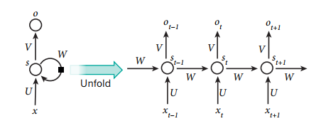
Recurrent Neural Networks
Y. LeCun, Y. Bengio, and G. Hinton, “Deep learning,” Nature, vol. 521, no. 7553, pp. 436–444, 2015.
Notes:
So now let us talk about recurrent neural networks, or RNNs. To put it simply, recurrent neural networks have connections between nodes where the outputs from previous time steps are fed as input to the current time step so that it forms a directed or undirected graph along a temporal sequence. One advantage is that this allows the network to maintain a state vector in their hidden units that contains info on all the past elements of the sequence. This allows the recurrent network make predictions from over a lot of time steps. Thus, RNNs are preferable for tasks that involves training in things such as predicting the next character or word in the text.
One effective way to visualize these recurrent networks is through what the industry calls unfolding. In the diagram showing in front of you right now, s are the nodes at different timestep from which the hidden units grouped under, x are the input sequence and o are the output sequence. S,x and o are with respect to time, or t. On the otherhand, U,V and W matrix parameters stay constant with respect to time. The black square that seems to be going in the clockwise direction, is used to depict the nodes getting the input from the previous steps (or x with respect to t in this case) and maps it into an output sequence that is labeled as o with respect to t. And thus the output will depend on all of the previous sequence inputs.

Slide 16

Long Short Term Memory
Notes:
One interesting thing mentioned from the paper is that RNNs have problems with learn long-term dependencies, with which when we read related literature this is due to vanishing gradient. I find this a bit interesting as from the diagram before, U,V, and W matrices should be constant throughout with respect to time. Nevertheless, long short-term memory is a type of RNN that has a memory cell with which it copies itself while accumulate the external signal. These LSTM networks are proved to be more effective and also enables innovation such as entire speech recognition system.

